Slide 1
Statistical Estimation Theory

Slide 2
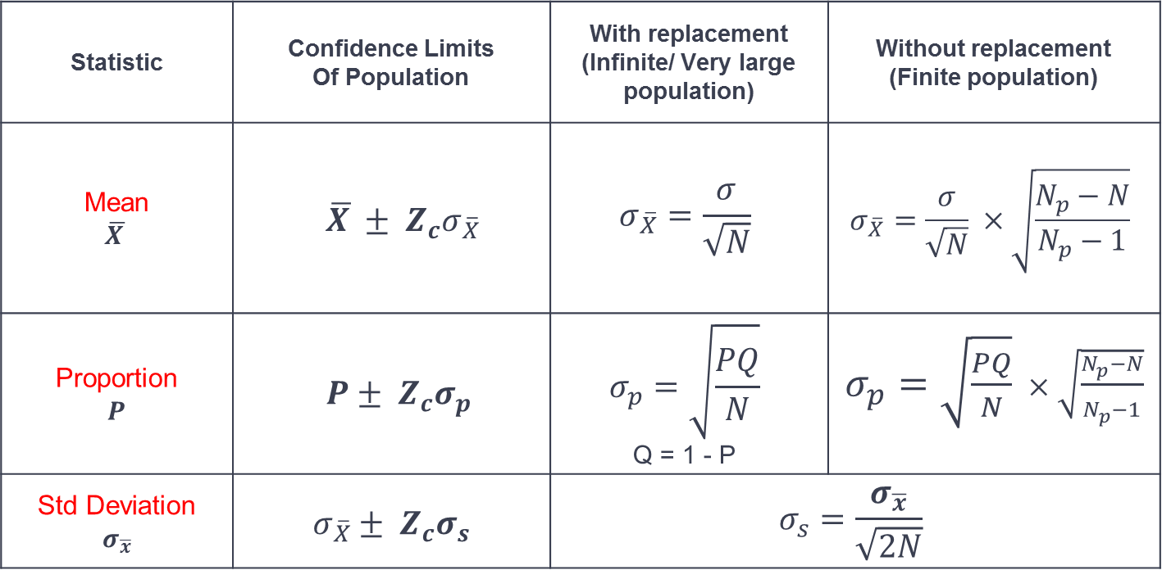
Confidence Intervals
Statistic | Confidence Limits Of Population | With replacement (Infinite/ Very large population) | Without replacement (Finite population)
Mean $$\overline{X }$$ | $$\overline{X }± Z_{c}σ_{\overline{X}}$$ | $$σ_{\overline{X}}=\frac{σ}{\sqrt{N}}$$ | $$σ_{\overline{X}}=\frac{σ}{\sqrt{N}} ×\sqrt{\frac{N_{p}−N}{N_{p}−1}}$$
Proportion $$P$$ | $$P± Z_{c}σ_{p}$$ | $$σ_{p}=\sqrt{\frac{PQ}{N}}$$ Q = 1 - P | $σ_{p}=\sqrt{\frac{PQ}{N}} ×\sqrt{\frac{N_{p}−N}{N_{p}−1}}$
Std Deviation $$σ_{\overline{x}}$$ | $$σ_{\overline{X}}± Z_{c}σ_{s}$$ | $$σ_{s}=\frac{σ_{\overline{x}}}{\sqrt{2N}}$$

Slide 3
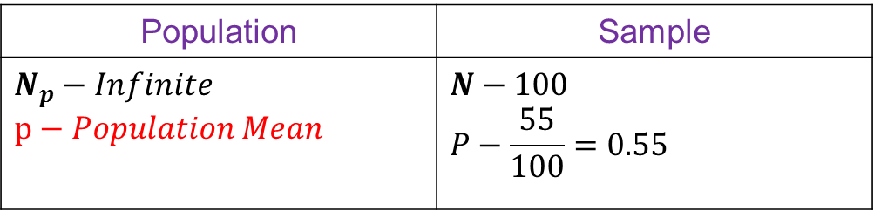
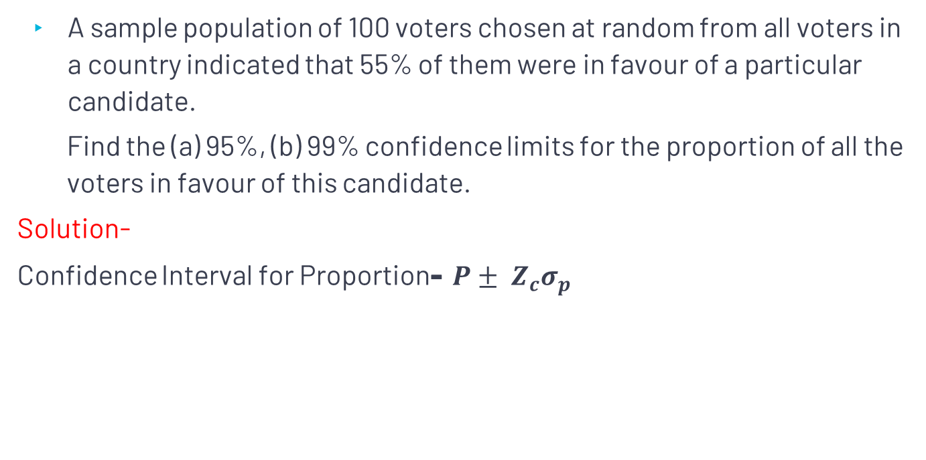
Question
A sample population of 100 voters chosen at random from all voters in a country indicated that 55% of them were in favour of a particular candidate.
Find the (a) 95%, (b) 99% confidence limits for the proportion of all the voters in favour of this candidate.
Solution-
Confidence Interval for Proportion- $P± Z_{c}σ_{p}$
Population | Sample
$$N_{p}−Infinite$$ $$p−Population Mean$$ | $$N−100$$ $$P−\frac{55}{100}=0.55$$

Slide 4
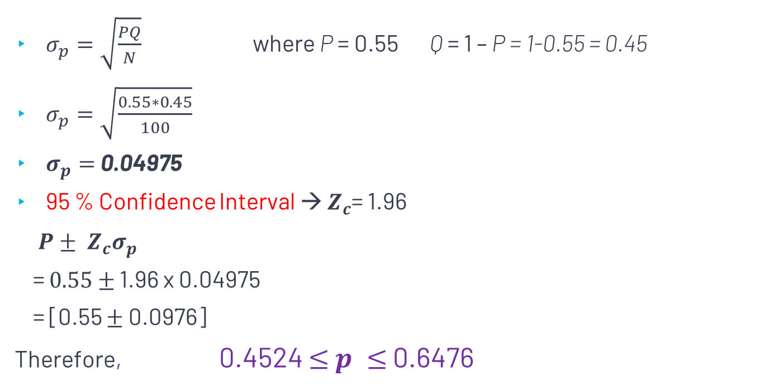
cont..
$σ_{p}=\sqrt{\frac{PQ}{N}}$ where P = 0.55 Q = 1 – P = 1-0.55 = 0.45
$σ_{p}=\sqrt{\frac{0.55∗0.45}{100}}$
$σ_{p}=$ 0.04975
95 % Confidence Interval → $Z_{c}$= 1.96
$P± Z_{c}σ_{p}$
= $0.55$ $±$ 1.96 x 0.04975
= [0.55 $±$ 0.0976]
Therefore, 0.4524 $≤$ $p ≤$ 0.6476

Slide 5

cont..
99 % Confidence Interval → $Z_{c}$= 2.58
$P± Z_{c}σ_{p}$
= $0.55$ $±$ 2.58 x 0.04975
= [0.55 $±$ 0.1284]
Therefore, 0.4216 $≤$ $p ≤$ 0.6784

Slide 6
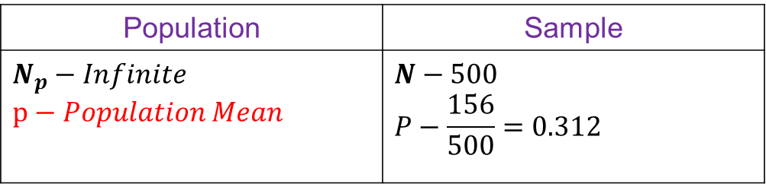
Question
A survey is conducted, and it is found that 156 out of 500 adult males are smokers. Find the (a) 95%, (b) 99% confidence limits for the proportion of all the adults in favour of smoking.
Solution-
Population | Sample
$$N_{p}−Infinite$$ $$p−Population Mean$$ | $$N−500$$ $$P−\frac{156}{500}=0.312$$
Confidence Interval for Proportion- $P± Z_{c}σ_{p}$

Slide 7
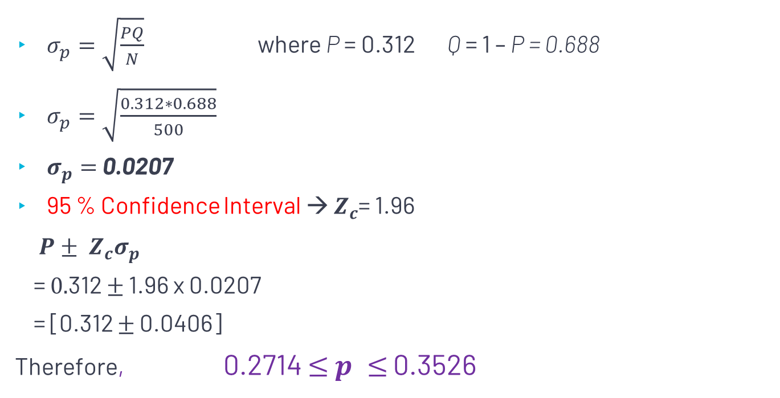
cont..
$σ_{p}=\sqrt{\frac{PQ}{N}}$ where P = 0.312 Q = 1 – P = 0.688
$σ_{p}=\sqrt{\frac{0.312∗0.688}{500}}$
$σ_{p}=$ 0.0207
95 % Confidence Interval → $Z_{c}$= 1.96
$P± Z_{c}σ_{p}$
= $0.$312 $±$ 1.96 x 0.0207
= [0.312 $±$ 0.0406]
Therefore, 0.2714 $≤$ $p ≤$ 0.3526

Slide 8

cont..
99 % Confidence Interval → $Z_{c}$= 2.58
$P± Z_{c}σ_{p}$
= $0.312$ $±$ 2.58 x 0.0207
= [0.312 $±$ 0.0534]
Therefore, 0.2586 $≤$ $p ≤$ 0.3654

Slide 9

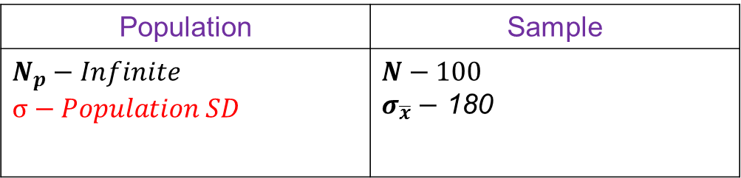
Question
The standard deviation of the breaking strengths of 100 cables tested by a company was 180 𝑙𝑏. Find the (a) 95%, (b) 99%, and (c) 99.73% confidence limits for the standard deviation of all cables produced by the company.
Solution-
Population | Sample
$$N_{p}−Infinite$$ $$σ−Population SD$$ | $$N−100$$ $σ_{\overline{x}}−$ 180
Confidence Interval for SD-${ σ}_{\overline{X}} ± Z_{c}σ_{s}$

Slide 10

Cont..
$σ_{s}=\frac{σ_{\overline{x}}}{\sqrt{2N}}$
$σ_{s}=\frac{180}{\sqrt{2∗100 }}$
$σ_{s}=12. 7279$

Slide 11
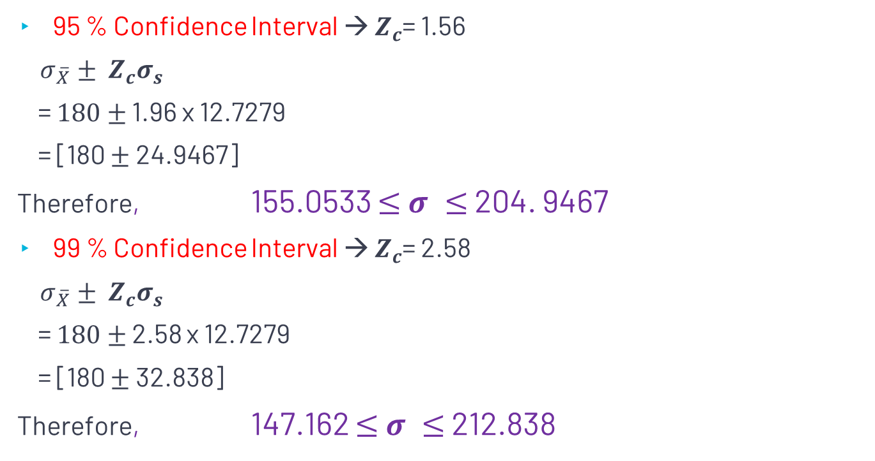
cont..
95 % Confidence Interval → $Z_{c}$= 1.56
${ σ}_{\overline{X}} ± Z_{c}σ_{s}$
= $180$ $±$ 1.96 x 12.7279
= [180 $±$ 24.9467]
Therefore, 155.0533 $≤$ $σ ≤$ 204. 9467
99 % Confidence Interval → $Z_{c}$= 2.58
${ σ}_{\overline{X}} ± Z_{c}σ_{s}$
= $180$ $±$ 2.58 x 12.7279
= [180 $±$ 32.838]
Therefore, 147.162 $≤$ $σ ≤$ 212.838

